Slide 1

CSA-06 DESIGN AND ANALYSIS OF ALORITHMS
Comparative Growth Analysis of Algorithms
Presented By:
CH.POORNA TEJA(192472149

Slide 2
Introduction
Algorithm analysis measures how efficiently an algorithm works.
Big-O notation shows how running time grows with input size. Ø Common complexities are O(log n), O(n), O(n log n), and O(n²). Ø Efficient algorithms save time and computing resources.
Comparing growth rates helps choose the best algorithm.
Problem Statement

Slide 3
Problem Statement
Large datasets require efficient algorithms.
Slow algorithms take more time as input size increases.
Compare O(log n), O(n), O(n log n), and O(n²).
Identify which complexity grows the fastest.
Select the most suitable algorithm for large inputs.

Slide 4
Algorithm / Pseudocode
Start
Input different values of
Calculate O(log n), O(n), O(n log n), and O(n²) Display the comparison table
Analyze the growth of each algorithm Stop

Slide 5
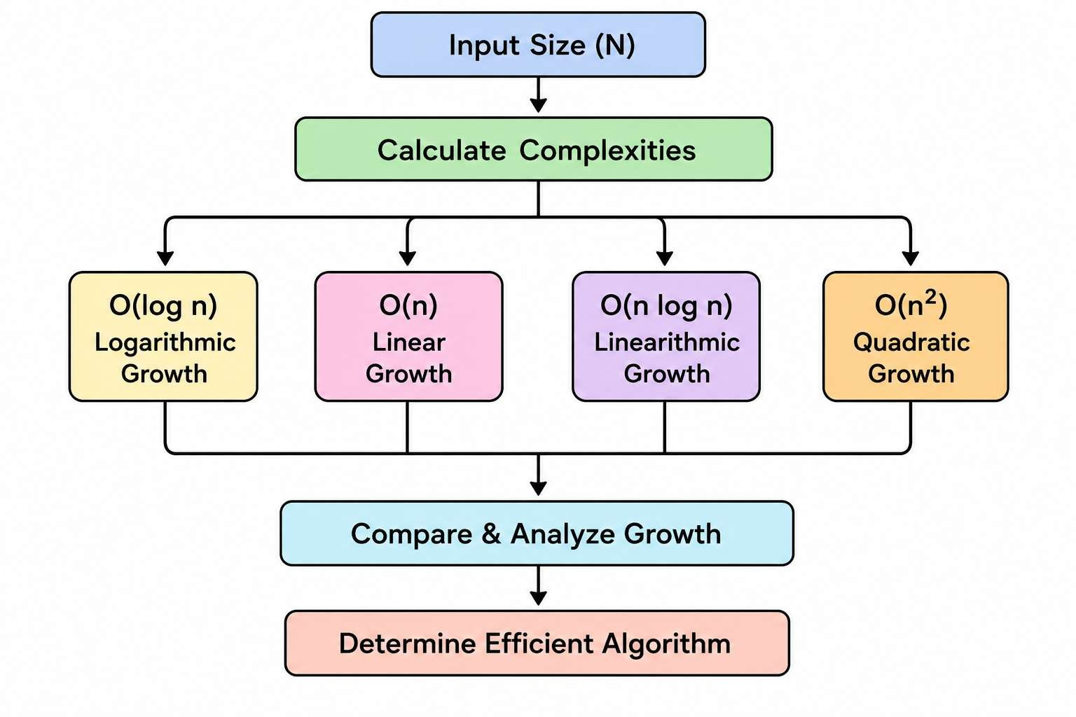
Architecture Diagram

Slide 6
Implementation (Python Code)
import math
n = [10, 100, 1000]
print(" \tO(logn)\tO(n)\tO(n logn)\tO(n²)")
for i in n:
print(i, "\t",
round(math.log2(i),2), "\t", i, "\t",
round(i*math.log2(i),2), "\t",
i*i)

Slide 7
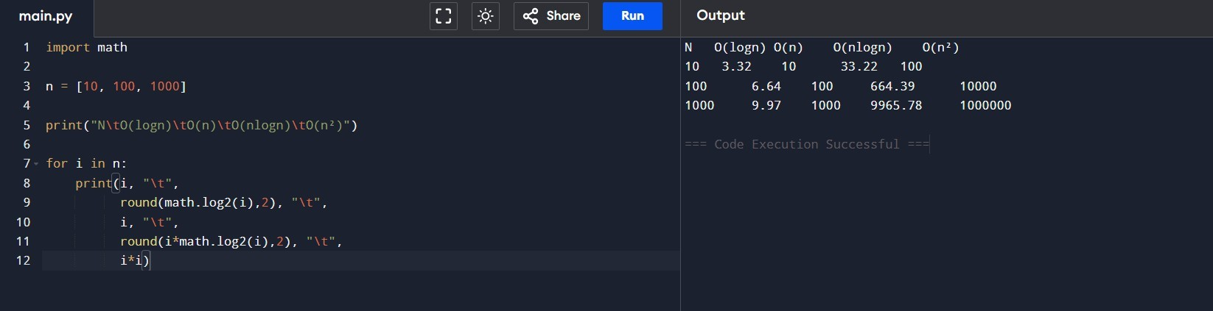
Output

Slide 8
Complexity Analysis
Complexity | Growth | Example
O(log n) | Very Slow | Binary Search
O(n) | Slow | Linear Search
O(n log n) | Medium | Merge Sort
O(n²) | Very Fast | Bubble Sort

Slide 9
Conclusion
O(log n) is the most efficient for large inputs.
O(n) is suitable for simple data processing.
O(n log n) is best for efficient sorting algorithms.
O(n²) becomes very slow for large datasets.
Lower Big-O complexity gives better performance.

Slide 10
References
Thomas H. Cormen et al., Introduction to Algorithms, 4th Edition.
Robert Sedgewick, Algorithms, 4th Edition.
Donald E. Knuth, The Art of Computer Programming.

Slide 11
Thank You

